Slide 1
Skoolbot: Visual Programming Environment for 3D Printed Robots
Group 15

Slide 2
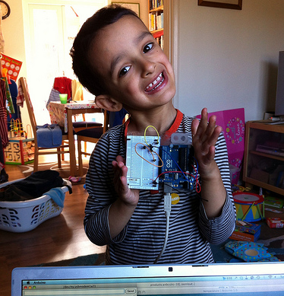
Background
Students love robots
Programming is hard to start
Schools have restricted computing environment
Non of the existed similar platforms (e.g. scratch) has interaction with hardware

Slide 3
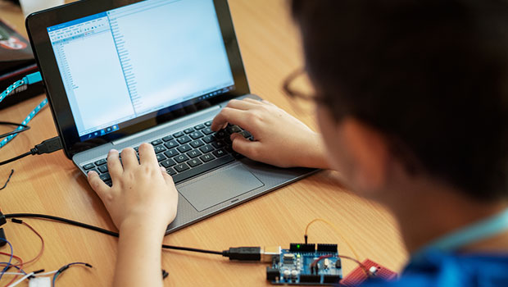
Objectives
Platform for non-experience programmer
Primary Student
Linguistics not a trouble
Cheap and easy access platform
Program with blocks
Drag and drop
Notes:
The problem that the primary students are having:
slow at typing,
not good at spelling but they are capable of making simple programs.
We should not let the linguistics to be the trouble for them from interest of programming
We have built a cheap and easy access platform with
Good visual programming instead text typing programming
The platform only need to drag or drop the blocks to program

Slide 4
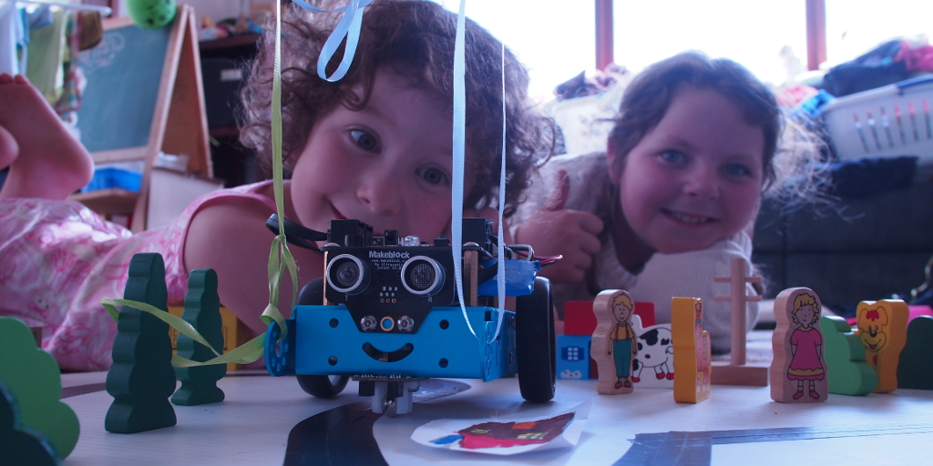
Motivation
First visual platform to interact with hardware (cross platform)
Websites or Apps (Online)
No installations of software
Restricted computing environment at school is not a problem
No deployment effort

Slide 5
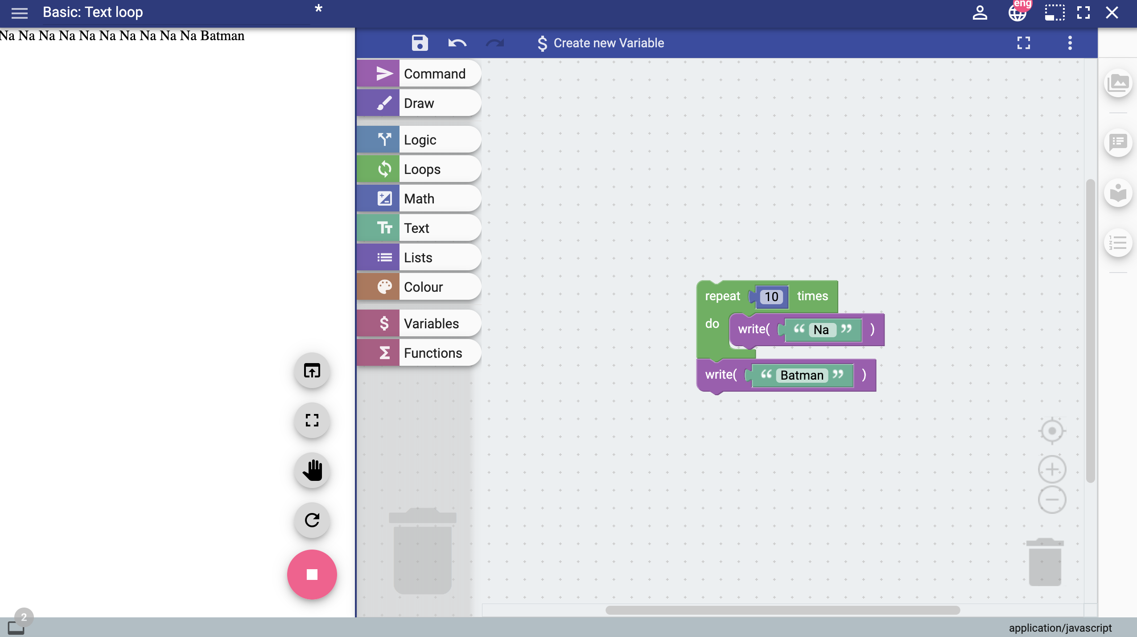
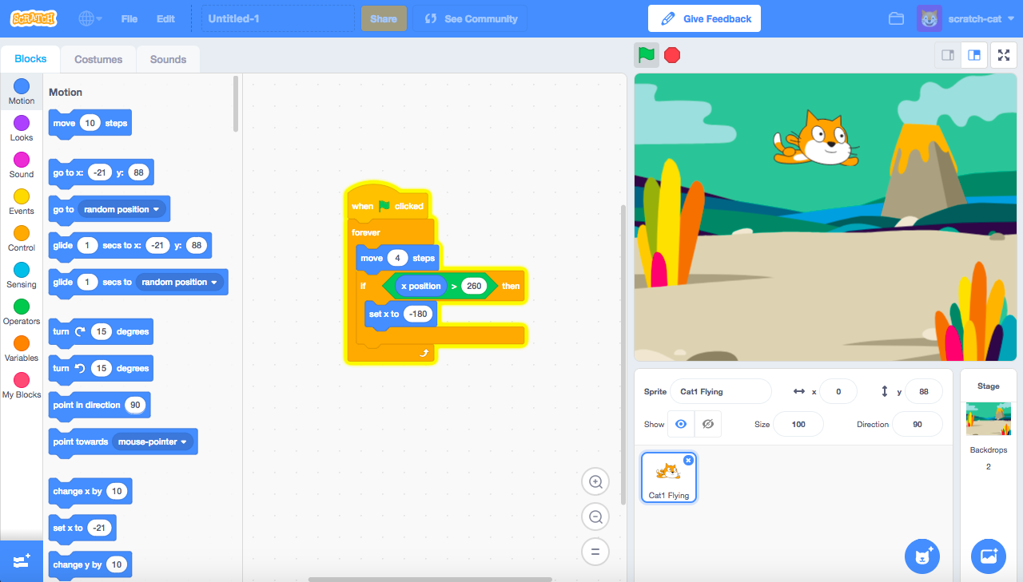
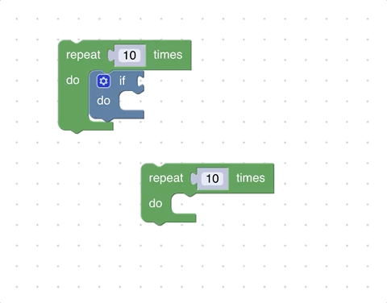
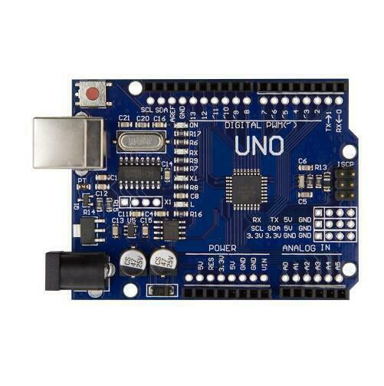
Related work
Many related work based on Google Blockly
Our project could connect to hardware with specific interpreter embedded
Notes:
Google Blockly provides an excellent Visual Programming Environment. Drag and drop blocks is very simple and easy to understand for those primary school students who would like to learn programming.
There are many related works based on Google Blockly library, such as to scratch. Our project is very similar to Scratch, but we are working on the connection between Blockly code and hardware.
Compared with those projects, the main advantage is that our project allows users to custom their program which could directly run on microprocessors such as Arduino board.
It is very significant in education field for young children who are interested in robots programming and would like to build something themselves.

Slide 6
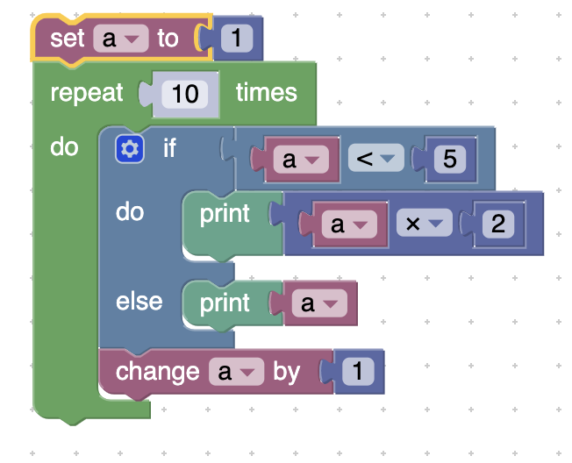
Implementation(abstract)
Blocks
Hardware
Intermediate Representation
(JSON)
Type checker
(Type Inference)
Bytecode
Interpreter deployed
Notes:
Design a new intermediate representation
Translation to IR
Type checker (type inference)
Design a new bytecode
Translator from IR to bytecode
Implement interpreter

Slide 7
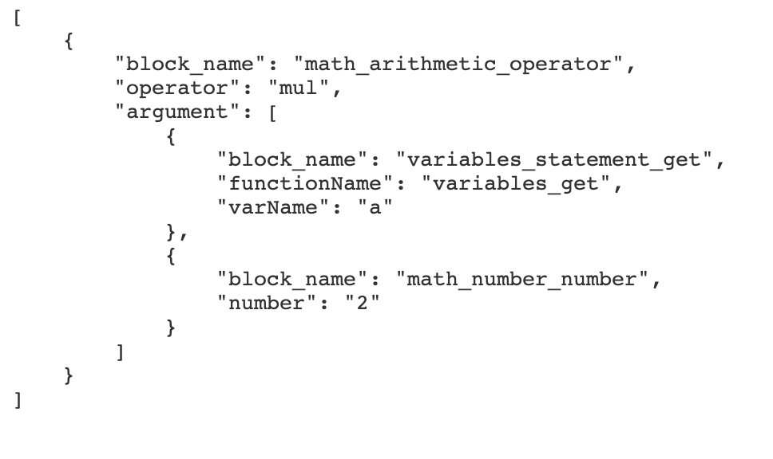
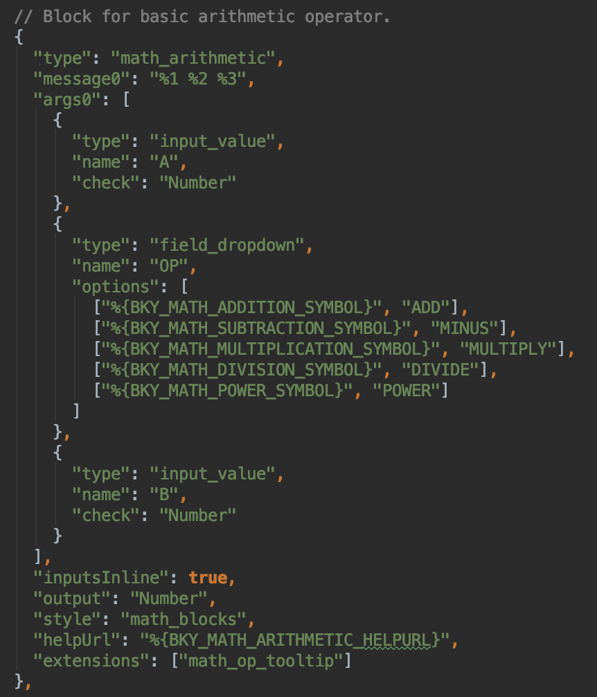
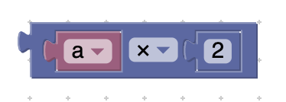
Blocks to Intermediate representation (JSON)
Blocks are defined in JSON
Extract key values from blocks
Generate proper JSON object as a intermediate representation
Notes:
Because we cannot process blocks directly, first step is to generate a JSON as an intermediate representation. Here is how the arithmetic block to be defined. The key values such as its two arguments “a” and “number two” with the option of the dropdown list would be extracted. And proper JSON format string can be generated from those key values. This is an example JSON of “a times 2”, first argument is variable a and second argument is number two. Operation is multiplication.

Slide 8
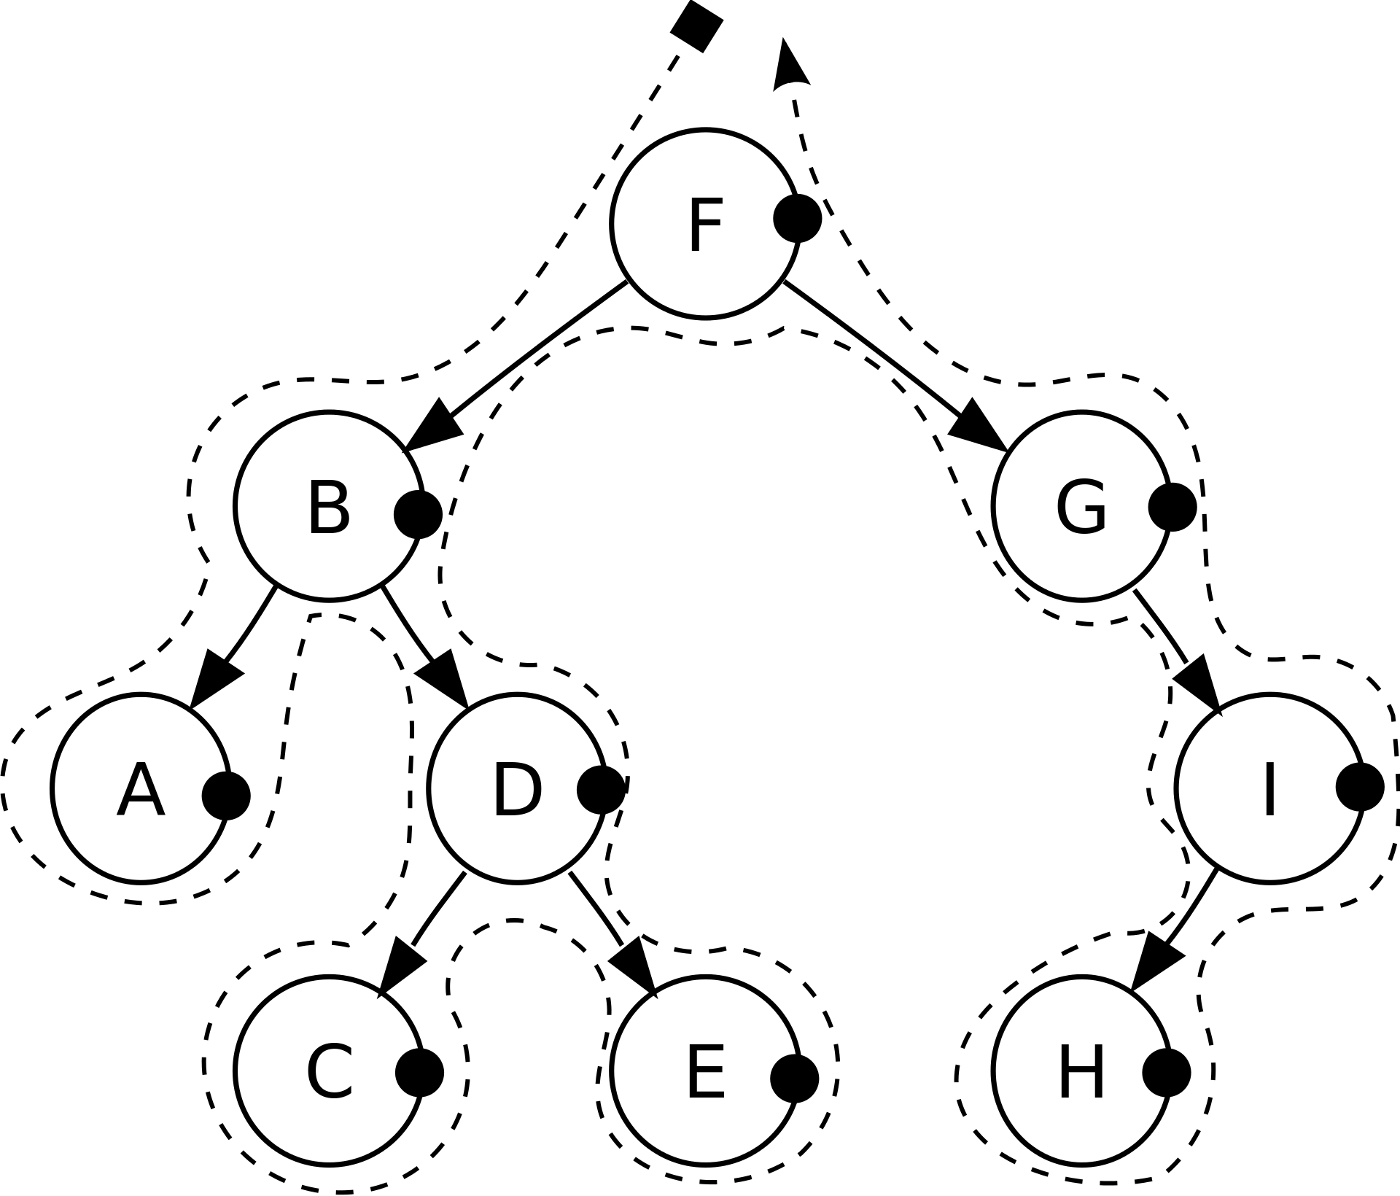
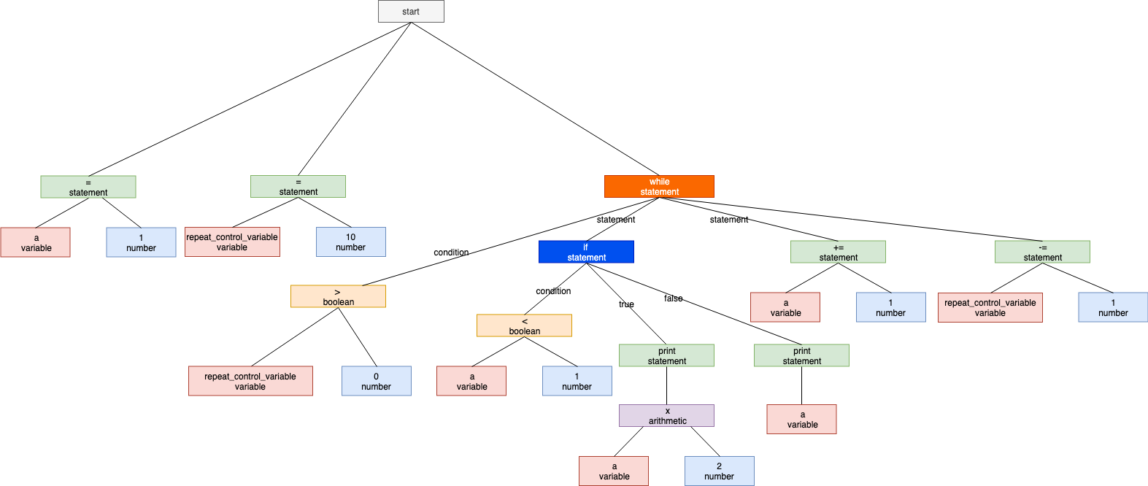
Type Inference
Post-order: A, C, E, D, B, H, I, G, F
post-order tree traversal to add value type to each block
Notes:
Now we can use JSON as an intermediate representation of certain program. Next we need to add type to each block for following generation.
JSON have its hierarchical structure just like a tree. In this step, we implement a recursively post-order tree traversal with type inference to add type field to each JSON blocks.
Here gives a tree as a hint for better understanding. In the tree, different color present different value type.
Sometimes we cannot give a value type to block directly such as this multiplication block. We need to check its type based on all its children blocks. That is why we use post-order traversal. It walks through the tree from bottom to top and give value type from children block to parent block

Slide 9
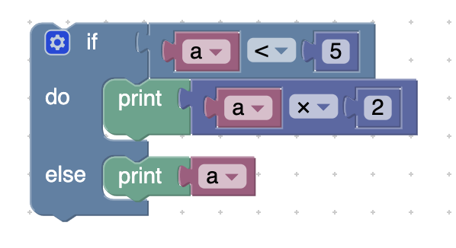
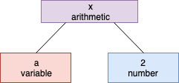
Bytecode Generation
bytecode code of math arithmetic
byrecode code of if-else
get a
number 5
cmpl
JUMPNZ L0_0
get a
number 2
mul
print
JUMP L1_1
L0_0
get a
print
L1_1
get a
number 2
mul
0x1b 0x00 0x00
0x01 0x02 0x00
0x04
true branch
false branch
Notes:
Now we are fully prepared to generate the bytecode which can be run on the hardware. Bytecode is also generated by the tree traversal. According to the post-order, the code generator should get the value of variable a first and give the number two then. Next is the operation of multiplication at the root node of the tree.
The Bytecode of if-else is similar, but it has both true branch and false branch. The code of condition should be generated first. And depend on the condition true or false, these JUMP command jump to different branch.

Slide 10
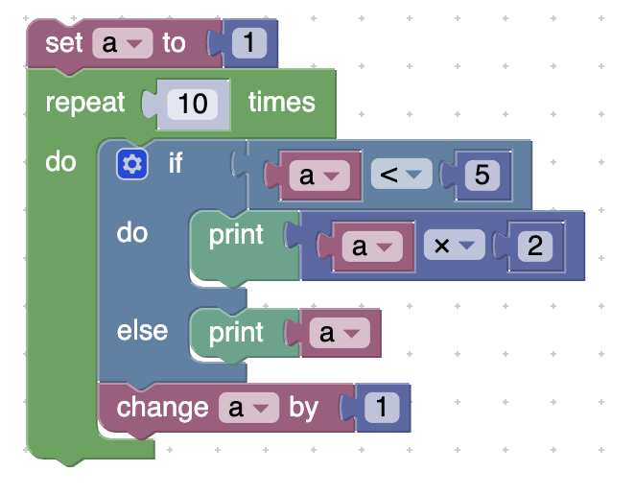
Bytecode Generation (cont’d)
bytecode code of loop
number 1
set a
number 10
set repeat_control_variable_0
L0_0
{ get a
number 5
cmpl
JUMPNZ L0_1
get a
number 2
mul
print
JUMP L1_2
L0_1
get a
Print
L1_2 } if statement
number 1
change a
get repeat_control_variable_0
number 1
sub
set repeat_control_variable_0
get repeat_control_variable_0
number 0
cmpg
JUMPNZ L1_0
JUMP L0_0
L1_0
Notes:
Loop blocks are similar. Depend on the condition it jumps to the beginning of the branch or jump out of the loop.

Slide 11
Program Memory​
Address | code
0 | number 1​​
1 | set a​​
2 | number 10​​
3 | set repeat_control_variable_0​​
4 | L0_0​​
5 | get a​​
6 | number 5​​
7 | cmpl​​
8 | JUMPNZ L0_1​​
9 | get a​​
10 | number 2​​
11 | mul​​
12 | print​​
13 | JUMP L1_2​​
14 | L0_1​​
15 | get a​​
16 | print​​
17 | L1_2​​
18 | number 1​​
19 | change a​​
20 | get repeat_control_variable_0​​
21 | number 1​​
22 | sub​​
23 | set repeat_control_variable_0​​
24 | get repeat_control_variable_0​​
25 | number 0​​
26 | cmpg​​
27 | JUMPNZ L1_0​​
28 | JUMP L0_0​​
29 | L1_0​​
Interpreter
Program Memory

Slide 12
Program Memory​
Address | code
0 | number 1​​
1 | set a​​
2 | number 10​​
3 | set repeat_control_variable_0​​
4 | L0_0​​
5 | get a​​
6 | number 5​​
7 | cmpl​​
8 | JUMPNZ L0_1​​
9 | get a​​
10 | number 2​​
11 | mul​​
12 | print​​
13 | JUMP L1_2​​
14 | L0_1​​
15 | get a​​
16 | print​​
17 | L1_2​​
18 | number 1​​
19 | change a​​
20 | get repeat_control_variable_0​​
21 | number 1​​
22 | sub​​
23 | set repeat_control_variable_0​​
24 | get repeat_control_variable_0​​
25 | number 0​​
26 | cmpg​​
27 | JUMPNZ L1_0​​
28 | JUMP L0_0​​
29 | L1_0​​
Stack Memory​
Address | content
0 | 1
1
2
3
4
5
6
7
8
9
10
Variable Memory​
Address | content
0
1
2
3
4
5
6
7
8
9
10

Slide 13
Program Memory​
Address | code
0 | number 1​​
1 | set a​​
2 | number 10​​
3 | set repeat_control_variable_0​​
4 | L0_0​​
5 | get a​​
6 | number 5​​
7 | cmpl​​
8 | JUMPNZ L0_1​​
9 | get a​​
10 | number 2​​
11 | mul​​
12 | print​​
13 | JUMP L1_2​​
14 | L0_1​​
15 | get a​​
16 | print​​
17 | L1_2​​
18 | number 1​​
19 | change a​​
20 | get repeat_control_variable_0​​
21 | number 1​​
22 | sub​​
23 | set repeat_control_variable_0​​
24 | get repeat_control_variable_0​​
25 | number 0​​
26 | cmpg​​
27 | JUMPNZ L1_0​​
28 | JUMP L0_0​​
29 | L1_0​​
Stack Memory​
Address | content
0
1
2
3
4
5
6
7
8
9
10
Variable Memory​
Address | content
0 | a = 1
1
2
3
4
5
6
7
8
9
10

Slide 14
Program Memory​
Address | code
0 | number 1​​
1 | set a​​
2 | number 10​​
3 | set repeat_control_variable_0​​
4 | L0_0​​
5 | get a​​
6 | number 5​​
7 | cmpl​​
8 | JUMPNZ L0_1​​
9 | get a​​
10 | number 2​​
11 | mul​​
12 | print​​
13 | JUMP L1_2​​
14 | L0_1​​
15 | get a​​
16 | print​​
17 | L1_2​​
18 | number 1​​
19 | change a​​
20 | get repeat_control_variable_0​​
21 | number 1​​
22 | sub​​
23 | set repeat_control_variable_0​​
24 | get repeat_control_variable_0​​
25 | number 0​​
26 | cmpg​​
27 | JUMPNZ L1_0​​
28 | JUMP L0_0​​
29 | L1_0​​
Stack Memory​
Address | content
0 | 10
1
2
3
4
5
6
7
8
9
10
Variable Memory​
Address | content
0 | a = 1
1
2
3
4
5
6
7
8
9
10

Slide 15
Program Memory​
Address | code
0 | number 1​​
1 | set a​​
2 | number 10​​
3 | set repeat_control_variable_0​​
4 | L0_0​​
5 | get a​​
6 | number 5​​
7 | cmpl​​
8 | JUMPNZ L0_1​​
9 | get a​​
10 | number 2​​
11 | mul​​
12 | print​​
13 | JUMP L1_2​​
14 | L0_1​​
15 | get a​​
16 | print​​
17 | L1_2​​
18 | number 1​​
19 | change a​​
20 | get repeat_control_variable_0​​
21 | number 1​​
22 | sub​​
23 | set repeat_control_variable_0​​
24 | get repeat_control_variable_0​​
25 | number 0​​
26 | cmpg​​
27 | JUMPNZ L1_0​​
28 | JUMP L0_0​​
29 | L1_0​​
Stack Memory​
Address | content
0
1
2
3
4
5
6
7
8
9
10
Variable Memory​
Address | content
0 | a = 1
1 | repeat_control_variable_0​​ = 10
2
3
4
5
6
7
8
9
10

Slide 16
Program Memory​
Address | code
0 | number 1​​
1 | set a​​
2 | number 10​​
3 | set repeat_control_variable_0​​
4 | L0_0​​
5 | get a​​
6 | number 5​​
7 | cmpl​​
8 | JUMPNZ L0_1​​
9 | get a​​
10 | number 2​​
11 | mul​​
12 | print​​
13 | JUMP L1_2​​
14 | L0_1​​
15 | get a​​
16 | print​​
17 | L1_2​​
18 | number 1​​
19 | change a​​
20 | get repeat_control_variable_0​​
21 | number 1​​
22 | sub​​
23 | set repeat_control_variable_0​​
24 | get repeat_control_variable_0​​
25 | number 0​​
26 | cmpg​​
27 | JUMPNZ L1_0​​
28 | JUMP L0_0​​
29 | L1_0​​
Stack Memory​
Address | content
0 | 1
1
2
3
4
5
6
7
8
9
10
Variable Memory​
Address | content
0 | a = 1
1 | repeat_control_variable_0​​ = 10
2
3
4
5
6
7
8
9
10

Slide 17
Program Memory​
Address | code
0 | number 1​​
1 | set a​​
2 | number 10​​
3 | set repeat_control_variable_0​​
4 | L0_0​​
5 | get a​​
6 | number 5​​
7 | cmpl​​
8 | JUMPNZ L0_1​​
9 | get a​​
10 | number 2​​
11 | mul​​
12 | print​​
13 | JUMP L1_2​​
14 | L0_1​​
15 | get a​​
16 | print​​
17 | L1_2​​
18 | number 1​​
19 | change a​​
20 | get repeat_control_variable_0​​
21 | number 1​​
22 | sub​​
23 | set repeat_control_variable_0​​
24 | get repeat_control_variable_0​​
25 | number 0​​
26 | cmpg​​
27 | JUMPNZ L1_0​​
28 | JUMP L0_0​​
29 | L1_0​​
Stack Memory​
Address | content
0 | 1
1 | 5
2
3
4
5
6
7
8
9
10
Variable Memory​
Address | content
0 | a = 1
1 | repeat_control_variable_0​​ = 10
2
3
4
5
6
7
8
9
10

Slide 18
Program Memory​
Address | code
0 | number 1​​
1 | set a​​
2 | number 10​​
3 | set repeat_control_variable_0​​
4 | L0_0​​
5 | get a​​
6 | number 5​​
7 | cmpl​​
8 | JUMPNZ L0_1​​
9 | get a​​
10 | number 2​​
11 | mul​​
12 | print​​
13 | JUMP L1_2​​
14 | L0_1​​
15 | get a​​
16 | Print​​
17 | L1_2​​
18 | number 1​​
19 | change a​​
20 | get repeat_control_variable_0​​
21 | number 1​​
22 | sub​​
23 | set repeat_control_variable_0​​
24 | get repeat_control_variable_0​​
25 | number 0​​
26 | cmpg​​
27 | JUMPNZ L1_0​​
28 | JUMP L0_0​​
29 | L1_0​​
Stack Memory​
Address | content
0 | 0 (true)
1
2
3
4
5
6
7
8
9
10
Variable Memory​
Address | content
0 | a = 1
1 | repeat_control_variable_0​​ = 10
2
3
4
5
6
7
8
9
10
cmpl = compare less

Slide 19
Program Memory​
Address | code
0 | number 1​​
1 | set a​​
2 | number 10​​
3 | set repeat_control_variable_0​​
4 | L0_0​​
5 | get a​​
6 | number 5​​
7 | cmpl​​
8 | JUMPNZ L0_1​​
9 | get a​​
10 | number 2​​
11 | mul​​
12 | print​​
13 | JUMP L1_2​​
14 | L0_1​​
15 | get a​​
16 | print​​
17 | L1_2​​
18 | number 1​​
19 | change a​​
20 | get repeat_control_variable_0​​
21 | number 1​​
22 | sub​​
23 | set repeat_control_variable_0​​
24 | get repeat_control_variable_0​​
25 | number 0​​
26 | cmpg​​
27 | JUMPNZ L1_0​​
28 | JUMP L0_0​​
29 | L1_0​​
Stack Memory​
Address | content
0
1
2
3
4
5
6
7
8
9
10
Variable Memory​
Address | content
0 | a = 1
1 | repeat_control_variable_0​​ = 10
2
3
4
5
6
7
8
9
10
JUMPNZ = jump not zero

Slide 20
Program Memory​
Address | code
0 | number 1​​
1 | set a​​
2 | number 10​​
3 | set repeat_control_variable_0​​
4 | L0_0​​
5 | get a​​
6 | number 5​​
7 | cmpl​​
8 | JUMPNZ L0_1​​
9 | get a​​
10 | number 2​​
11 | mul​​
12 | print​​
13 | JUMP L1_2​​
14 | L0_1​​
15 | get a​​
16 | print​​
17 | L1_2​​
18 | number 1​​
19 | change a​​
20 | get repeat_control_variable_0​​
21 | number 1​​
22 | sub​​
23 | set repeat_control_variable_0​​
24 | get repeat_control_variable_0​​
25 | number 0​​
26 | cmpg​​
27 | JUMPNZ L1_0​​
28 | JUMP L0_0​​
29 | L1_0​​
Stack Memory​
Address | content
0 | 1
1
2
3
4
5
6
7
8
9
10
Variable Memory​
Address | content
0 | a = 1
1 | repeat_control_variable_0​​ = 10
2
3
4
5
6
7
8
9
10

Slide 21
Program Memory​
Address | code
0 | number 1​​
1 | set a​​
2 | number 10​​
3 | set repeat_control_variable_0​​
4 | L0_0​​
5 | get a​​
6 | number 5​​
7 | cmpl​​
8 | JUMPNZ L0_1​​
9 | get a​​
10 | number 2​​
11 | mul​​
12 | print​​
13 | JUMP L1_2​​
14 | L0_1​​
15 | get a​​
16 | print​​
17 | L1_2​​
18 | number 1​​
19 | change a​​
20 | get repeat_control_variable_0​​
21 | number 1​​
22 | sub​​
23 | set repeat_control_variable_0​​
24 | get repeat_control_variable_0​​
25 | number 0​​
26 | cmpg​​
27 | JUMPNZ L1_0​​
28 | JUMP L0_0​​
29 | L1_0​​
Stack Memory​
Address | content
0 | 1
1 | 2
2
3
4
5
6
7
8
9
10
Variable Memory​
Address | content
0 | a = 1
1 | repeat_control_variable_0​​ = 10
2
3
4
5
6
7
8
9
10

Slide 22
Program Memory​
Address | code
0 | number 1​​
1 | set a​​
2 | number 10​​
3 | set repeat_control_variable_0​​
4 | L0_0​​
5 | get a​​
6 | number 5​​
7 | cmpl​​
8 | JUMPNZ L0_1​​
9 | get a​​
10 | number 2​​
11 | mul​​
12 | print​​
13 | JUMP L1_2​​
14 | L0_1​​
15 | get a​​
16 | print​​
17 | L1_2​​
18 | number 1​​
19 | change a​​
20 | get repeat_control_variable_0​​
21 | number 1​​
22 | sub​​
23 | set repeat_control_variable_0​​
24 | get repeat_control_variable_0​​
25 | number 0​​
26 | cmpg​​
27 | JUMPNZ L1_0​​
28 | JUMP L0_0​​
29 | L1_0​​
Stack Memory​
Address | content
0 | 2
1
2
3
4
5
6
7
8
9
10
Variable Memory​
Address | content
0 | a = 1
1 | repeat_control_variable_0​​ = 10
2
3
4
5
6
7
8
9
10
mul = multiplication

Slide 23
Program Memory​
Address | code
0 | number 1​​
1 | set a​​
2 | number 10​​
3 | set repeat_control_variable_0​​
4 | L0_0​​
5 | get a​​
6 | number 5​​
7 | cmpl​​
8 | JUMPNZ L0_1​​
9 | get a​​
10 | number 2​​
11 | mul​​
12 | print​​
13 | JUMP L1_2​​
14 | L0_1​​
15 | get a​​
16 | print​​
17 | L1_2​​
18 | number 1​​
19 | change a​​
20 | get repeat_control_variable_0​​
21 | number 1​​
22 | sub​​
23 | set repeat_control_variable_0​​
24 | get repeat_control_variable_0​​
25 | number 0​​
26 | cmpg​​
27 | JUMPNZ L1_0​​
28 | JUMP L0_0​​
29 | L1_0​​
Stack Memory​
Address | content
0
1
2
3
4
5
6
7
8
9
10
Variable Memory​
Address | content
0 | a = 1
1 | repeat_control_variable_0​​ = 10
2
3
4
5
6
7
8
9
10

Slide 24
Program Memory​
Address | code
0 | number 1​​
1 | set a​​
2 | number 10​​
3 | set repeat_control_variable_0​​
4 | L0_0​​
5 | get a​​
6 | number 5​​
7 | cmpl​​
8 | JUMPNZ L0_1​​
9 | get a​​
10 | number 2​​
11 | mul​​
12 | print​​
13 | JUMP L1_2​​
14 | L0_1​​
15 | get a​​
16 | print​​
17 | L1_2​​
18 | number 1​​
19 | change a​​
20 | get repeat_control_variable_0​​
21 | number 1​​
22 | sub​​
23 | set repeat_control_variable_0​​
24 | get repeat_control_variable_0​​
25 | number 0​​
26 | cmpg​​
27 | JUMPNZ L1_0​​
28 | JUMP L0_0​​
29 | L1_0​​
Stack Memory​
Address | content
0
1
2
3
4
5
6
7
8
9
10
Variable Memory​
Address | content
0 | a = 1
1 | repeat_control_variable_0​​ = 10
2
3
4
5
6
7
8
9
10

Slide 25
Program Memory​
Address | code
0 | number 1​​
1 | set a​​
2 | number 10​​
3 | set repeat_control_variable_0​​
4 | L0_0​​
5 | get a​​
6 | number 5​​
7 | cmpl​​
8 | JUMPNZ L0_1​​
9 | get a​​
10 | number 2​​
11 | mul​​
12 | print​​
13 | JUMP L1_2​​
14 | L0_1​​
15 | get a​​
16 | print​​
17 | L1_2​​
18 | number 1​​
19 | change a​​
20 | get repeat_control_variable_0​​
21 | number 1​​
22 | sub​​
23 | set repeat_control_variable_0​​
24 | get repeat_control_variable_0​​
25 | number 0​​
26 | cmpg​​
27 | JUMPNZ L1_0​​
28 | JUMP L0_0​​
29 | L1_0​​
Stack Memory​
Address | content
0
1
2
3
4
5
6
7
8
9
10
Variable Memory​
Address | content
0 | a = 1
1 | repeat_control_variable_0​​ = 10
2
3
4
5
6
7
8
9
10

Slide 26
Demonstration – Escape from the Darkness
Use the photo resistor to control the speed of the DC motor.
Used LED as an indicator
Use serial monitor to display speed
Use the potentiometer to control the brightness of the LED
Blockly instead of C++
Notes:
Explain the blocks

Slide 27

Discussion and Evaluation
More variable type
Procedure blocks (functions)
More IO blocks
More hardware function blocks according to the Arduino
Make tutorials for students
Future work
Notes:
We would like to discuss about some meaningful future work.
More variable type. currently it only support integer type. More types of value are expected to add in the project such as float, string, and list.
Procedure blocks could be added which allow users to define functions.
More IO blocks can be created
And more hardware function blocks will support more electronic component
Make tutorials for students with some simple example as a good start.

Slide 28
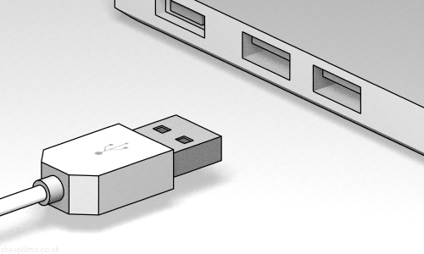
Conclusion and reflection
The demonstration was one of the results of our project
You can make the hardware to do anything with our platform
We have :
A good testing structure
Wrap everything into an app (easy to import and access)
Serial communication (other hardware)

